Slide 1
Transaction Management
Tuesday, 23/02/2021

Slide 2
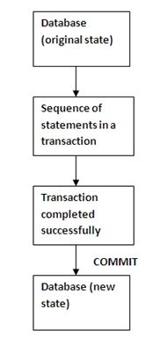
A transaction is a unit of work performed against the database. It is a set of work (T-SQL statements) that are executed together such as a single unit in a specific logical order as a single unit.
If statements are executed successfully then the transaction is complete and then it is committed that saves the data in the database permanently. If any single statement fails then the entire transaction will fail and the complete transaction will be cancelled or rolled back. When a transaction starts, it locks all the table data that is used in the transaction. Hence during the transaction life cycle no one can modify this table data used by the transaction such that the the integrity of the data for the transaction is maintained.

Slide 3
Let us see an example of a bank that has two customers, Cust_A and Cust_B. In case Cust_A wants to transfer some money to Cust_B, then there are the following 3 possibilities:
Debiting from the Cust_A account is performed successfully and crediting in the Cust_B account is performed successfully.
Neither debiting from the Cust_A account is performed nor crediting in the Cust_B account is performed.
Debiting from the Cust_A account is performed successfully, but crediting in the Cust_B account is not performed.
The first condition indicates a successful transaction and the second condition is not so critical. We are not required to do any retransmission, but the third condition will create a problem if, due to a technical problem, the first operation is successful but the second one fails. The result here would be that the Cust_A account will be debited, but the Cust_B account will not be credited. This means that we will lose the information. For overcoming all these problems we can use transaction management. A transaction ensures that either a debit or a credit will be be done or nothing will be done.

Slide 4
A transaction mainly consists of 4 properties that are also known as ACID rules. Atomicity: Atomic means that all the work in the transaction is treated as a single unit. Either it is performed completely or none of it is and at the point of failure the previous operations are rolled back to their former state. Consistency: Transactions ensure that the database properly changes states upon a successfully committed transaction. In other words, if a transaction completes successfully then the database should be in a new state that will reflect changes else the transaction remains in the same state as at an initial point. Isolation: It ensures that transactions operate independently and are transparent to each other. In other words, if more than one transections are running then they do not effect each other. Durability: It ensures that the effect of committed transactions will save in the database permanently and should persist no matter what happens (like in a power failure).

Slide 5
Types of Transactions
In SQL, transactions are of the following two types:
Implicit Transactions
Explicit Transactions
Implicit Transactions Implicit transactions in the SQL language are performed by a DML query (insert, update and delete) and DDL query (alter, drop, truncate and create) statements. All these queries are handled by Implicit Transactions.
When any DDL or DML query is performed then the system stores the information of all the operations in the log file. If any error occurs then the SQL Server will rollback the complete statement.
Explicit Transactions An explicit transaction is defined and controlled by the user on a DML query (insert, update or delete). A transaction is not applied on a SELECT command because is doesn't affect the data. A transaction is not used in creating tables or dropping them because these operations are automatically committed in the database.

Slide 6
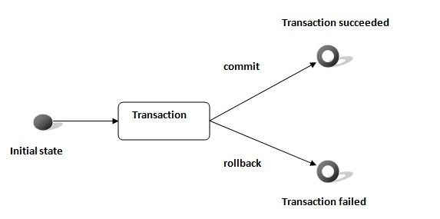
Transaction Control The following commands are used in the transaction control mechanism.
BEGIN: To initiate a transaction.
COMMIT: To save changes. After the commit command, the transaction can't rollback.
SAVEPOINT: Provides points where the transaction can rollback to.
ROLLBACK: To rollback to a previous saved state.

Slide 7
Create Table Student
(
Id int Not Null primary key,
Name Nvarchar(20) Not NUll,
Age Int Not Null,
Class int not Null
)
Insert Into Student
Select 1,'A',12,10 Union All
Select 2,'B',16,11 Union All
Select 3,'C',15,9 Union All
Select 4,'D',13,12 Union All
Select 5,'E',14,11
-- Explicit transaction
-- Example1
Begin Transaction My_Trans
Delete from Student Where Id=3
Begin Rollback Transaction My_Trans
End
Select * From Student

Slide 8
--Example2
Begin Transaction My_Trans
Delete from Student Where Id=4
Commit Transaction My_Trans
--example 3
Begin Transaction My_Trans
Rollback Transaction My_Trans
SELECT * FROM Student

Slide 9
Begin Transaction Trans
Begin Try
Delete From Student Where Student.Id=3;
Update Student Set Student.Name=12121 ,
Student.Class='12th' Where Student.Id=5 /* Error Will Occur Here */
print @@TranCount
If @@TranCount>0
begin Commit Transaction Trans
End
End Try
Begin Catch
if @@TranCount>0
Print 'Error Is Occur in Transaction'
begin Rollback Transaction Trans
End
End Catch
select * from Student

Slide 10
Spring Transaction – Advantages
Offers both programmatic and declarative transactions
Declartive transactions are equivalent to the container managed transactions and there is no need for an application server
No need for using JTA.
Wide ranges of Transactional Managers defined in spring transaction API.

Slide 11
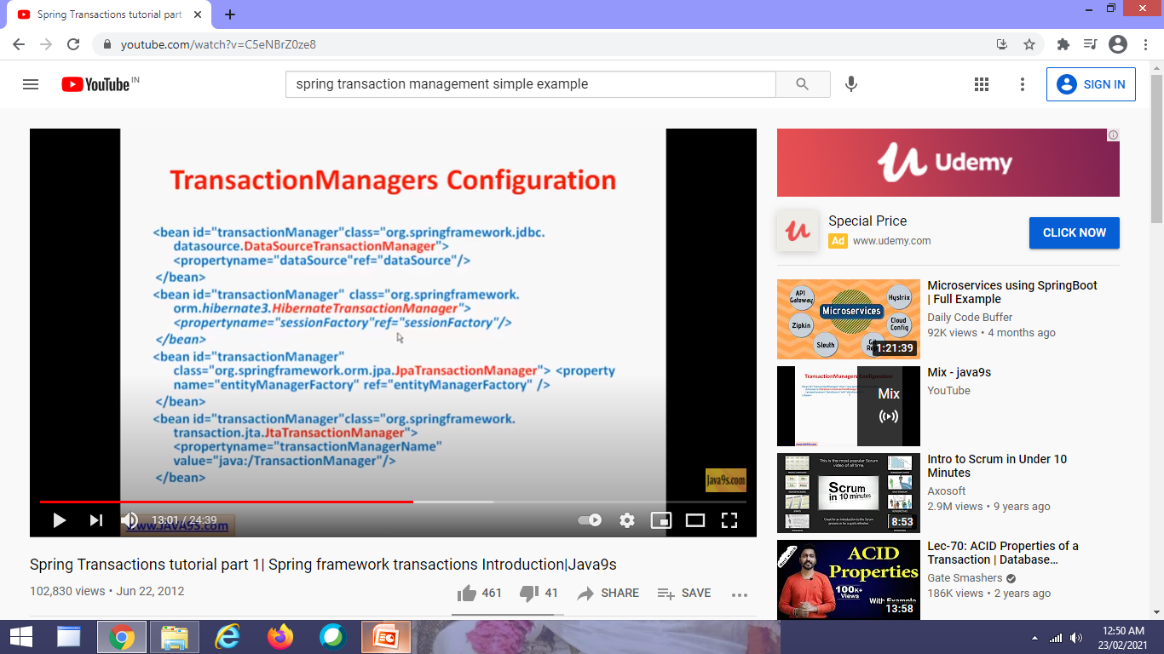
TransactionManagers Configuration

Slide 12
Conclusion
Transaction Management A- C
Locking Mechanism I- D

